Slide 1
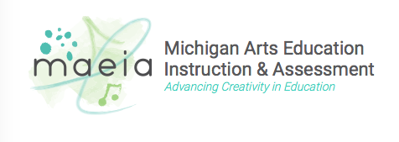
Overview of the MAEIA Assessments
Module 2
IN THE MAEIA MODULE SERIES
Notes:
Welcome to this Introduction to the Michigan Arts Education Instruction and Assessment Project.
In the next few minutes, I will describe some of the important aspects of this ground-breaking project.
I will be describing how to select the MAEIA assessments you want to use.

Slide 2
Purposes of MAEIA Project
Improve the quality of your arts education program
Monitor and improve student learning in the arts
Support professional practice and improve teacher effectiveness
Advance arts as a core element of public education
Notes:
The MAEIA project was commissioned by the Michigan Department of Education. It was developed by the Michigan Assessment Consortium in concert with Data Recognition Corporation, and in partnership with over 1,000 Michigan Educators.
The purposes for MAEIA are to help arts educators
improve their arts education programs,
to monitor and improve student learning in the arts,
to support professional practice and improve your effectiveness as a teachers, and ultimately,
to advance arts education as a key part of a well-rounded education.

Slide 3
Overview of the Module Series
1
Introduction to the MAEIA Project
Overview of the MAEIA Assessments
Overview of the Content Standards Assessed by the MAEIA Assessments
Selecting the MAEIA Assessments
Navigating the MAEIA Website
Administering the MAEIA Assessments
Scoring and Reporting the MAEIA Assessments
Using the MAEIA Assessments to Demonstrate Educator Effectiveness
6
2
7
3
8
4
5
Notes:
There are 8 modules in this module series.
They describe the MAEIA program, and the MAEIA resources available to you, including the MAEIA assessments.
The module series describes how to select, use, score and report the MAEIA assessments.
This module focuses on providing an overview of the MAEIA assessments.

Slide 4
Purposes of this Module
Provide an overview of how the MAEIA assessments were created, edited, reviewed, field tested, revised, and finalized
Describe the different types of assessments that are available
Describe how these assessments can be used for different purposes and in different contexts
Notes:
The purposes of this module is to
describe how the MAEIA assessments were developed, edited, reviewed, field tested, revised, and finalized,
describe the different types of assessments that are available, and
describe how these assessments can be used for different purposes and in different contexts.

Slide 5
MAEIA Four-Year Development Plan
Develop and Publish Arts Education Instructional Blueprint and Supporting Research.
Develop Program Review Tool.
Create the Assessment Specifications Document.
High School Item Writing, Content Review, and Booklet Production.
Professional Development for Year 1 Tools.
Begin K-8 Item Writing.
Field Testing of High School Assessments.
Item Writing, Content Review, & Booklet Production for K-8.
Professional Development for Year 1 and 2 Tools.
Revise and Refine HS Items –Score and Attach Exemplars.
Field Testing of K-8 Assessments.
Further HS Field Testing.
Revise and Refine K-8 Items - Score and Attach Exemplars.
Professional Development on MAEIA Tools/Resources.
Creation of MAEIA Website for All Tools and Resources.
Year 1
2012 - 2013
Year 2
2013 - 2014
Year 3
2013 - 2014
Year 4
2015 - 2016
Notes:
The MAEIA resources were created over a four-year period as shown in this slide.
In Year 1, Assessment Specifications Documents or ASDs were created in each content area. The ASDs are available on the MAEIA website.
In Year 2, the ASDs were used to develop the MAEIA high school assessments. The assessments were reviewed for content by educators and revised when recommended.
Development of Grade K-8 assessments was also started in Year 2.
In Year 3, the high school assessments were field tested and the K-8 assessments were reviewed, and revised. The high school items were scored to select exemplary student work as well as to revise the items as necessary.
In Year 4, the K-8 assessments were field tested and scored for exemplars of student work, and if indicated, they were also revised. Additional high school and K-8 assessments were developed.
All assessments were reviewed one last time, revised as necessary, and loaded into the MAEIA website.

Slide 6
Types of Assessment Items
The MAEIA assessments are
a combination of Performance Tasks, Performance Events, and
Related Constructed-and Selected-Response items.
They are intended to be used over the course of a year, in conjunction with arts instruction.
Notes:
There are several types of MAEIA assessments – a combination of Performance Tasks, Performance Events, and Constructed- and Selected-response items embedded in the tasks and events.
These assessments are intended to be used by arts educators over the course of the school year.

Slide 7
Types of Assessments
Performance Tasks
Performance Tasks are carried out by individual students or small groups of students over time (days, weeks, months).
Tasks are carried out in or out of class, but very much related to instruction (e.g., class assignments)
Tasks measure essential outcomes in the content standards not easily measured in other ways
Performances are judged using one or more scoring rubrics
Notes:
The first type of assessment is a Performance Task. Performance Tasks are intended to be carried out over time, such as multiple class periods, usually in class (but occasionally outside of class).
These are substantial assessments that measure concepts not easy to measure in other ways.
Student work on these assessments individually or in small groups.
Students’ work is judged by the teacher using one or more Teacher Scoring Rubrics, each with multiple dimensions in them.

Slide 8
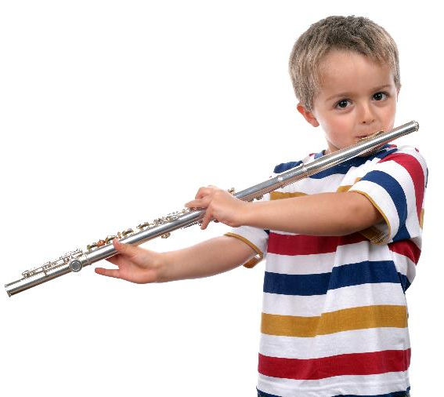
Types of Assessments
Performance Events
Performance Events are administered “on-demand,” without any or just a brief amount of rehearsal time.
May be individual or small group assessments
Test administrator presents items to one student or a small group of students, who respond in “real” time
Performances are judged using one or more scoring rubrics
Notes:
Performance Events are shorter assessments, typically completed by students in just one class period.
These are “on-demand’ assessments in which students create first draft work or perform without prior rehearsal.
Students also work on these assessments individually or in small groups.
Student work is also judged by the teacher using one or more Teacher Scoring Rubrics, each with multiple dimensions in them.

Slide 9
Types of Assessments
Constructed Response
Items in which students write a response to a prompt
Can usually be administered to groups of students
Some type of stimulus (e.g., music selection, video, or picture) could be used
Task may involve writing, sketching, constructing a table, as well as a written response
Performances are judged using one or more scoring rubrics
Notes:
Constructed, or written, response items require students to write a response to a prompt which may be a short or more extended written piece, an artist sketch, musical composition, or other comparable response.
Student work is also judged by the teacher using one or more Teacher Scoring Rubrics, each with multiple dimensions in them.

Slide 10
Types of Assessments
Selected Response
Items related to the assessment. The student is given a prompt (a question or a statement) and answer choices.
Student has to select either the correct answer or the most correct answer
Multiple-choice questions are the most popular form of Selected Response
In MAEIA, these items are used to tap content knowledge or procedural knowledge needed to respond to Performance Tasks, Performance Events or Constructed Response items; there are no stand-alone Selected-Response items
Notes:
The final item type is Selected-Response items. These are typically multiple-choice items where students read a question or prompt and selects the correct or most correct response to the question or prompt.
In MAEIA, these items are used to tap content knowledge or procedural knowledge needed to respond to performance tasks or events; there are no stand-alone selected-response items.

Slide 11
Types of Assessments
Performance Tasks
Think “theatrical production”
Performance Events
Think “sight-reading”
Constructed Response
Think “student reflection”
Selected Response
Think “select the correct answer”
Notes:
This slide provides a quick summary of the four assessment types. This may help you keep them straight in your mind.

Slide 12
Development of the MAEIA Assessments
Developed by certified arts educators in each of the four arts disciplines
Based on 2011 Michigan K-12 Arts Content Standards, Benchmarks and Grade Level Content Expectations
Translated into performance standards:
Create, Perform, Respond
Aligned to NCCAS Framework
Assessment methods appropriately reflect the demands of each discipline
Notes:
As this slide notes, the MAEIA assessments
were developed by certified arts educators in each of the four arts disciplines.
are based on 2011 Michigan K-12 Arts Content Standards, Benchmarks and Grade Level Content Expectations.
measure the three key aspects of the creative process – create, perform/present, and respond, using assessment methods that appropriately reflect each discipline.

Slide 13
Development of the MAEIA Assessments
Teams of arts educators selected by the MAC to create the items
Teams met twice and after each meeting, the work was lightly edited and suggestions given to improve the items
Final draft items were first edited by the MAC project team
Then items were reviewed by DRC Assessment staff
Items were finalized by the MAC and prepared for field testing
Notes:
Teams of arts educators were selected by the MAC
Each development team met twice, for a total of about 5 days.
Teams were trained in item writing and the standards to be assessed
Each writer produced several items. These items were edited by MAEIA curriculum and assessment staff, giving item writers suggestions for improving their work
After the second meeting, writers submitted their work, which was again edited by MAEIA curriculum and assessment staff, and then by DRC editors. MAEIA staff did the final production work to prepare the items for field testing, which DRC facilitated.

Slide 14
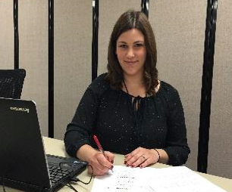
MAEIA Assessments
“
I appreciate that these assessments were written by people like me. We all teach to the same standards, so there were so many in the catalogue that aligned to what I teach already. I learned a few new ways of teaching certain concepts. I would use the same ones again.
“
Karen Knaebel
Dance Teacher
Everett High School
Lansing, MI
Notes:
Here is a quote from a teacher who participated in the development and field testing of the MAEIA assessments.

Slide 15
Field Testing the MAEIA Assessments
Any assessment with stakes for teachers and/or students should be piloted or field tested before it is used to make important decisions.
AERA/APA/NCME Standards for Educational and Psychological Testing
All high-quality assessments are field tested
before they are used to make important decisions.
Issues explored in field testing include:
Are items written so that teachers and students understand them?
Do the items assess what they are intended to assess?
Does the item result in assessable student work?
Can the scoring rubrics be revised or strengthened?
Notes:
We followed professional standards that govern the development & use of assessments, as noted in this quote from the APA/AERA/NCME Standards for Educational and Psychological Testing
All high-quality assessments are field tested before being used to make important decisions about teachers or students.
Issues explored in field testing include
Are items written so that teachers and students understand them?
Do the items assess what they are intended to assess?
Does the item result in assessable student work?
Can the scoring rubrics be revised or strengthened?

Slide 16
Field Testing the MAEIA Assessments
“ONE OF THE MAEIA ASSESSMENT ITEMS I FIELD-TESTED was the design of a pop can label using the design styles of 20th century popular artists. They liked it because they could all relate to pop cans. I printed off what the students designed so they could actually apply it on their pop cans to show their peers.
Danielle
Benson-Fennell
Mona Shores H.S. Norton Shores, MI
Notes:
Here is a quote from a teacher who participated in the field testing of a MAEIA assessment. She reflects on student reactions to the assessment.

Slide 17
How can teachers use MAEIA Assessments?
MAEIA assessments provide teachers with ready-made opportunities to assess student learning in an organic, project-based way, which represents what actually happens in your class.
Notes:
So, you might ask, “how can I use the MAEIA assessments to support my instruction?”
As this slide notes, MAEIA assessments provide teachers with ready-made opportunities to assess student learning in an organic, project-based manner. The assessments thus fit nicely with what actually happens in your class.

Slide 18
How can teachers use MAEIA Assessments?
MAEIA assessments can be used in several ways:
to inform current instruction
to improve student learning and achievement
as a portion of educator
effectiveness demonstration
to improve future instruction and program improvement
Notes:
There are several ways that the MAEIA assessments can be used:
to inform current instruction
to improve student learning and achievement
as a portion of your demonstration of your effectiveness as an educator
to improve future instruction and program improvement

Slide 19
MAEIA’s Assessment Catalog
An online catalogue . . .
of more than 350 performance assessments
for grades K-12
across four arts disciplines (dance, theatre, music and visual arts)
is available for voluntary use by Michigan educators .
Notes:
The MAEIA assessments are available from the MAEIA website. When you go to the website, you will see that the items have been catalogued and are accessible to you in several ways.
There are more than 350 performance assessments suitable for K-12 (divided into subsets for K-2, 3-5, 6-8, and high school (9-12).
The assessments are available in dance, music, theatre, and visual arts.
All of these assessments are available to you and other arts educators on a voluntary basis for use as you provide instruction to your students.

Slide 20
Using MAEIA Assessments in Classrooms 2016 and Beyond
Purpose of published performance assessments in the arts is to improve teaching and learning in the arts.
Therefore, when using published assessments:
Teachers document only those processes and student products and performances as needed, e.g. for professional collaboration and improvement, as part of a teacher evaluation portfolio.
Teachers may retain only what is needed for the above.
Teachers are allowed to change the assessments to work for their classroom situations. School permission policy is sufficient to cover teacher use.
Notes:
In using the assessments in 2016 and beyond, teachers should note the purpose of the performance assessments is to improve your instruction and students’ learning.
Teachers can choose what parts of the assessments to document and retain for students, or for your professional portfolio for use in demonstrating your effectiveness.
Teachers can also adjust the assessments to better fit your planned instruction.

Slide 21
How can teachers implement MAEIA Assessments?
MAEIA assessments can be adapted to suit your needs and those of your students.
Change the language or adjust the time needed
Items can be moved up or down in grades level(s) in order to better fit the instructional level of your students
Use items across classes, across your department, or as independent instruction and assessment.
Use as a common measure with Artists-in-Residence from community and professional arts organizations
Notes:
As just mentioned, you have our permission to change the items to better fit your planned instruction. For example, language used in the items, the genre of music, the samples of visual arts images, videos of dance productions or theatrical performances can all be changed to fit with your instructional plans.
Items can be moved up or down in grades or levels to better fit your students.
Use items across classes, across your department, or as independent instruction and assessment.
Use as a common measure with Artists-in-Residence from community and professional arts organizations.

Slide 22
How can teachers implement MAEIA Assessments?
Build your assessment repertoire and use elements, such as rubrics, as stand alone tools to service everyday instruction.
Create a common assessment plan with colleagues within your discipline or your department to support your program, your teaching, and your students.
Notes:
This slide gives some additional suggestions for how the MAEIA assessments can be implemented.
For example, build your assessment repertoire and use elements, such as rubrics, as stand alone tools to service everyday instruction.
Create a common assessment plan with colleagues within your discipline or your department to support your program, your teaching, and your students.

Slide 23
My Administration Plan for MAEIA
Notes:
Here is a sample of the top of the two-page “My Administration Plan for MAEIA” planning tool which can be found on the MAEIA website.

Slide 24
MAEIA’s Assessment Catalog
An online catalogue of more than 350 performance assessments
. . . for grades K-12
. . . across four arts disciplines (dance, theatre,
music and visual arts)
… is available for voluntary use by Michigan
educators .
Notes:
Also available at the MAEIA website is the catalog of over 350 performance assessments in the arts I mentioned earlier. There are items suitable for grades K-2, 3-5, 6-8, and high school in dance, music, theatre, and visual arts.
Their use is voluntary so we hope that you use them to support and enhance the instruction you plan to provide to students.

Slide 25
MAEIA’s Assessment Catalog
When I looked at the catalogue of the items, I could see how so many of them are very close to what and how I teach.
I chose seven items to try in my Photography, Design and Painting classes.
Danielle
Benson-Fennell
Mona Shores H.S. Norton Shores, MI
Notes:
Here is a comment from the teacher we quoted before who looked at the MAEIA assessment catalog.

Slide 26
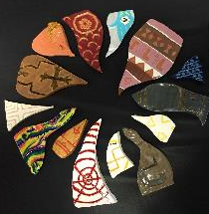
MAEIA Assessments
“
The MAEIA assessments can be part of your teaching tool box. I picked activities that I wouldn’t ordinarily choose--for instance, the Sculptures with Multiples assessment.
Incredible assessments, like this one, give your students an opportunity to be awesome. What my students did far surpassed my expectations.”
Amy Pobanz, Art Teacher John Glenn High School Bangor, MI
Notes:
Here is a comment from another teacher who has used the MAEIA assessments.
I think these teachers see the considerable utility of the MAEIA resources. We hope you do, too! Make sure to use this valuable gift to improve your instruction and the learning of your students.

Slide 27
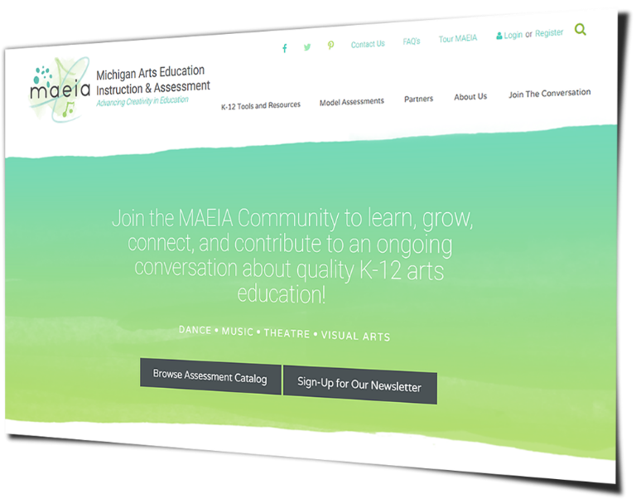
maeia-artsednetwork.org
Notes:
Be sure to join the community of arts educators to discuss these and other ideas.
Register on the site (see the word “Register” in the upper right hand corner) and join with other arts educators in improving your arts education programs.

Slide 28
Contact Us
MAEIA Project
517-816-4520
maeia.artsed@gmail.com
Notes:
And if you have any questions, contact us at this phone number or e-mail address.

