Slide 1
Scoring and Reporting the MAEIA Assessments
Module 7
IN THE MAEIA MODULE SERIES
Notes:
Welcome to this Introduction to the Michigan Arts Education Instruction and Assessment project.
In the next few minutes, I will describe some of the important characteristics of this ground-breaking project and introduce the resources you now have available to you.

Slide 2
Purposes of MAEIA Project
Improve the quality of your arts education program
Monitor and improve student learning in the arts
Support professional practice and improve teacher effectiveness
Advance arts as a core element of public education
Notes:
There are several Michigan Arts Education Instruction and Assessment or MAEIA project purposes.
The MAEIA project was commissioned by the Michigan Department of Education. It was developed by the Michigan Assessment Consortium working with the Data Recognition Corporation, in partnership with over 1,000 Michigan Educators.
The purposes for MAEIA are to help arts educators
improve their arts education programs,
monitor and improve student learning in the arts,
support professional practice and improve their effectiveness as teachers, and ultimately,
advance arts education as a key part of a well-rounded education.

Slide 3
Overview of the Module Series
Introduction to the MAEIA Project
Overview of the MAEIA Assessments
Overview of the Content Standards assessed by the MAEIA Assessments
Selecting the MAEIA Assessments
Navigating the MAEIA Website
Using the MAEIA Assessments
Scoring and Reporting the MAEIA Assessments
Using the MAEIA Assessments to Demonstrate Educator Effectiveness
Notes:
There are 8 modules that comprise this module series.
They describe the MAEIA project and the MAEIA resources including the MAEIA assessments.
The module series also describes how to select, use, score, and report the MAEIA assessments.
This module is about scoring the MAEIA assessments.

Slide 4
Purpose of this Module
Learn methods for scoring student work
Learn how to record scores assigned to student responses
Learn how to report student performance on each assessment in summary format and to individual students
Notes:
This module will cover several parts of the scoring of the MAEIA assessment, including
how to score student work
how and where to record students’ scores, and
how to report student performance on each assessment in summary form as well as to individual students.

Slide 5
Preparing to Score Student Work
After you’ve administered an assessment, collect all relevant materials
Student Booklets
Assessment Questions pages (if any) that students tore off of their Student Booklets
Any additional material that students produced not contained in the Student Booklets
Any audio or video files containing students’ performances
Notes:
There are several steps you should take to prepare to score students’ responses.
First, collect all of the assessment materials.
The Student Booklets
The assessment questions (if any) that students tore off their Student Booklets
Other materials that students produced such as artwork that is not in their Booklets
Any audio or video files containing their performances

Slide 6
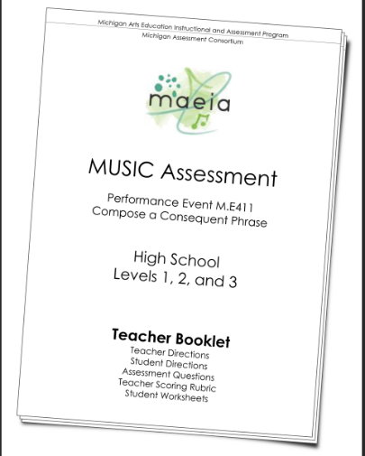
Preparing to Score Student Work
Begin the scoring process by re-reading the Teacher Booklet with special attention to the:
Assessment
Standards
Teacher Scoring Rubrics
Notes:
Second, become familiar again with the assessment, especially the standards that were assessed and the Teacher Scoring Rubrics and any special scoring directions.

Slide 7
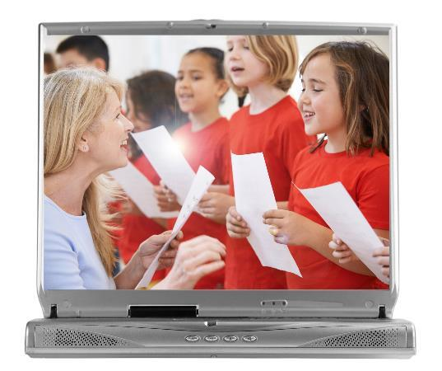
Preparing to Score Student Work
Set up any viewing/listening equipment needed to review audio/video files of students’ performances.
Notes:
Next, set up the playback equipment you’ll need to view video recordings or listen to audio recordings.

Slide 8
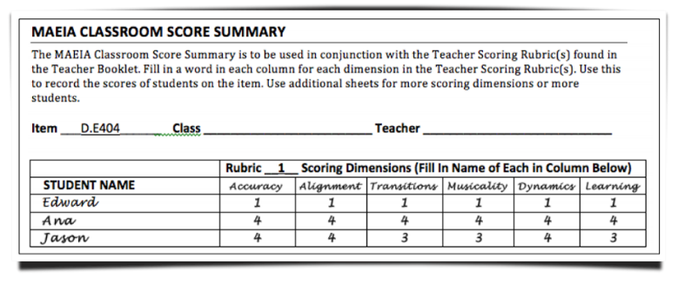
Preparing to Score Student Work
Fill out a MAEIA Classroom Score Summary with the names of each student who participated in the assessment. Use additional pages if necessary.
Do this for each Teacher Scoring Rubric in the assessment.
Notes:
Prepare to score student work by filling in their names on the MAEIA Classroom Score Summary contained in each Teacher Booklet.
You may need additional copies of it for large classes or if there is more than one Teacher Scoring Rubric in the assessment.

Slide 9
Review the Teacher Scoring Rubric
Read the Teacher Scoring Rubric carefully.
Look at the progression in the rubric from Level 1, the lowest level of performance, to Level 4, the highest level of performance.
How might students’ performances change or improve from Level 1 to Level 4?
Notes:
Look at each Teacher Scoring Rubric carefully.
Look at the progression in the rubric from Level 1, the lowest level of performance, to Level 2, to Level 3, and then to Level 4, the highest level of performance.
How do students’ performances change or improve from Level 1 to Level 4? These are the salient characteristics you should be looking for in students responses.
Repeat this for each dimension in the Teacher Scoring Rubric.

Slide 10
Informally Score a Few Responses
Informally (mentally) score an initial student on each dimension of the Teacher Scoring Rubric.
Do you see anything about the Teacher Scoring Rubric that is puzzling?
Notes:
Next, informally (mentally) score an initial student or two on each dimension of the Teacher Scoring Rubric.
Do you see anything about the Teacher Scoring Rubric that is puzzling? Can you fit a score to each student’s response?
Repeat this for each dimension in the Teacher Scoring Rubric.

Slide 11
Informally Score a Few Responses
Do this for a few more students.
Do you see any responses that are difficult to score?
Do you see anything that is puzzling?
Make note of these so you can provide feedback on these issues to the MAEIA project staff.
If this informal scoring seems to work, then return to the initial students’ work and score each of them.
Notes:
Do this for a few more students.
• Do you see any responses that are difficult to score?
• Do you see anything that is puzzling?
Make note of these so you can provide feedback on these issues to the MAEIA project.
If this informal scoring seems to work, then return to the initial students’ work and formally score each of them.

Slide 12
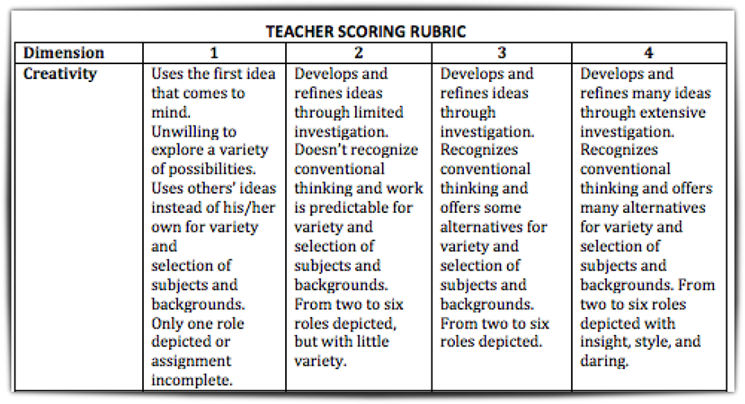
Sample Scoring Rubric – V.T406
Notes:
Here is one dimension of a sample Teacher Scoring Rubric. The dimension is “Creativity”.
You can see Levels 1 through 4. Remember that Level 1 is the lowest level of performance and Level 4 is the highest.
Next you are going to see a couple of student responses to this task – V.T406.

Slide 13
Example of Student Work Level 4
Notes:
Here is a sample Level 4 response.

Slide 14
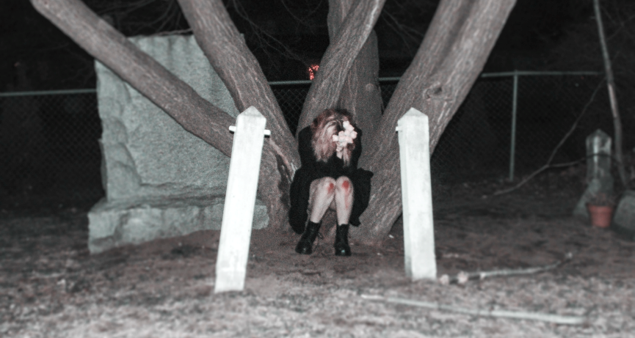
Example of Student Work Level 3
Notes:
Here is a sample Level 3 response.

Slide 15
Example of Student Work Level 2
Notes:
Here is a sample Level 2 response to this item.
By the way, these sample responses illustrate what you will find online for many of the MAEIA assessments.
The Teacher Scoring Rubrics can be looked at separately from the Teacher Booklets. Sample student responses like these are available for many performance levels for many of the dimensions for the Teacher Scoring Rubrics for a number of the assessments.

Slide 16
Scoring Student Work
Record students’ scores in the correct row and column on the MAEIA Classroom Score Summary.
Do this for all students on the first Teacher Scoring Rubric before moving on to a subsequent one (if there are multiple rubrics within an item).
Notes:
This slide shows a sample MAEIA Classroom Score Summary where you can record students’ scores.
Make sure to record students’ scores in the correct row and column on the MAEIA Classroom Score Summary.
Do this for all students on the first Teacher Scoring Rubric before moving on to a subsequent rubric, if there are multiple rubrics in the item.

Slide 17
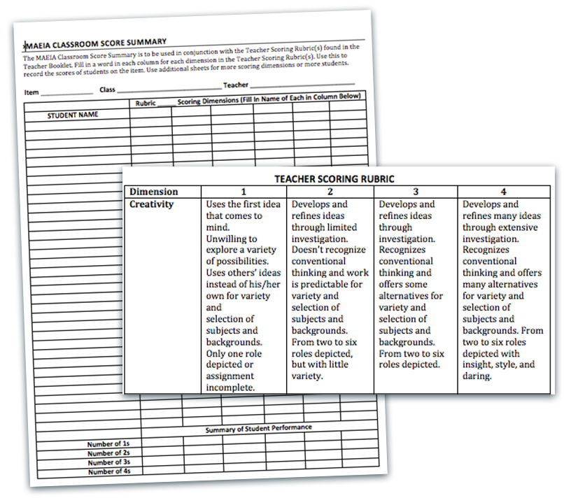
Notes:
This slide shows both one dimension of a Teacher Scoring Rubric and a blank MAEIA Classroom Score Summary.

Slide 18
Scoring Student Work
Make notes about any student responses that might be used to report to the class or individual students, or that might affect summaries of the results.
Notes:
As this slide says, make notes about any student responses that might be used to report to the class or individual students, or that might affect summaries of the results (positively or negatively).

Slide 19
Scoring Student Work
Continue to do this for each student who participated in the assessment, being careful to record the students’ scores in the correct row and column.
Repeat this for any additional Teacher Scoring Rubrics contained in the assessment.
Notes:
Score all students’ responses on all dimensions of the first Teacher Scoring Rubric, and then repeat this for any additional Teacher Scoring Rubrics.

Slide 20
Reporting Student Scores
When all student work has been scored, complete the summary section at the bottom of each MAEIA Classroom Score Summary sheet.
The summary section will indicate to you how well your students did as a group on the assessment.
1
2
Notes:
When all student work has been scored, complete the summary section at the bottom of each MAEIA Classroom Score Summary sheet, as shown on the next slide
The summary section will indicate to you how well your students did as a group on the assessment.

Slide 21
Add Summary Field to Score Summary
Notes:
Add this summary section at the bottom of each MAEIA Classroom Score Summary sheet for each Teacher Scoring Rubric as shown in this slide.
Then you should tally the total number of 1s, 2s, 3s, and 4s on each dimension of each Teacher Scoring Rubric.

Slide 22
Providing Feedback to Students
You may wish to provide feedback to
all students about how the class did on the assessment (using the overall summary scores), as well as to individual students.
In both cases, a focus on the areas for improvement in descriptive terms rather than using evaluative terms may be most helpful to students.
Notes:
As this slide says, you may wish to provide feedback to
• all students about how the class did on the assessment (using the overall summary scores), and
• to individual students.
In both cases, a focus on the areas for improvement in descriptive terms, rather than using evaluative terms, may be most helpful to students.

Slide 23
maeia-artsednetwork.org
Notes:
Be sure to join the community of arts educators. Register on the site (see the word “Register in the upper right hand corner), and join with other arts educators in improving your arts education programs.

Slide 24
Contact Us
MAEIA Project
517-816-4520
maeia.artsed@gmail.com
Notes:
If you have any questions, contact us at this phone number or e-mail address.

