Slide 1
1930’s
By: Hannah Huhn

Slide 2
Historical Influences
The Depression
Hollywood Movies
also known as the swing era
the growing threats of war in Europe
The Red Scare

Slide 3
Materials Often Used
wool
silk
fur
cotton
Darker or mellow colors for evening wear and brighter and “dizzier” patterns for house wives

Slide 4
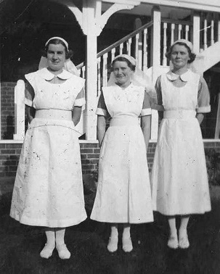
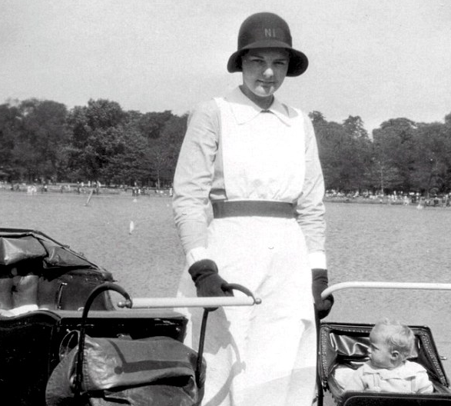
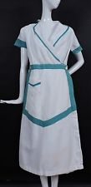
Nurses

Slide 5
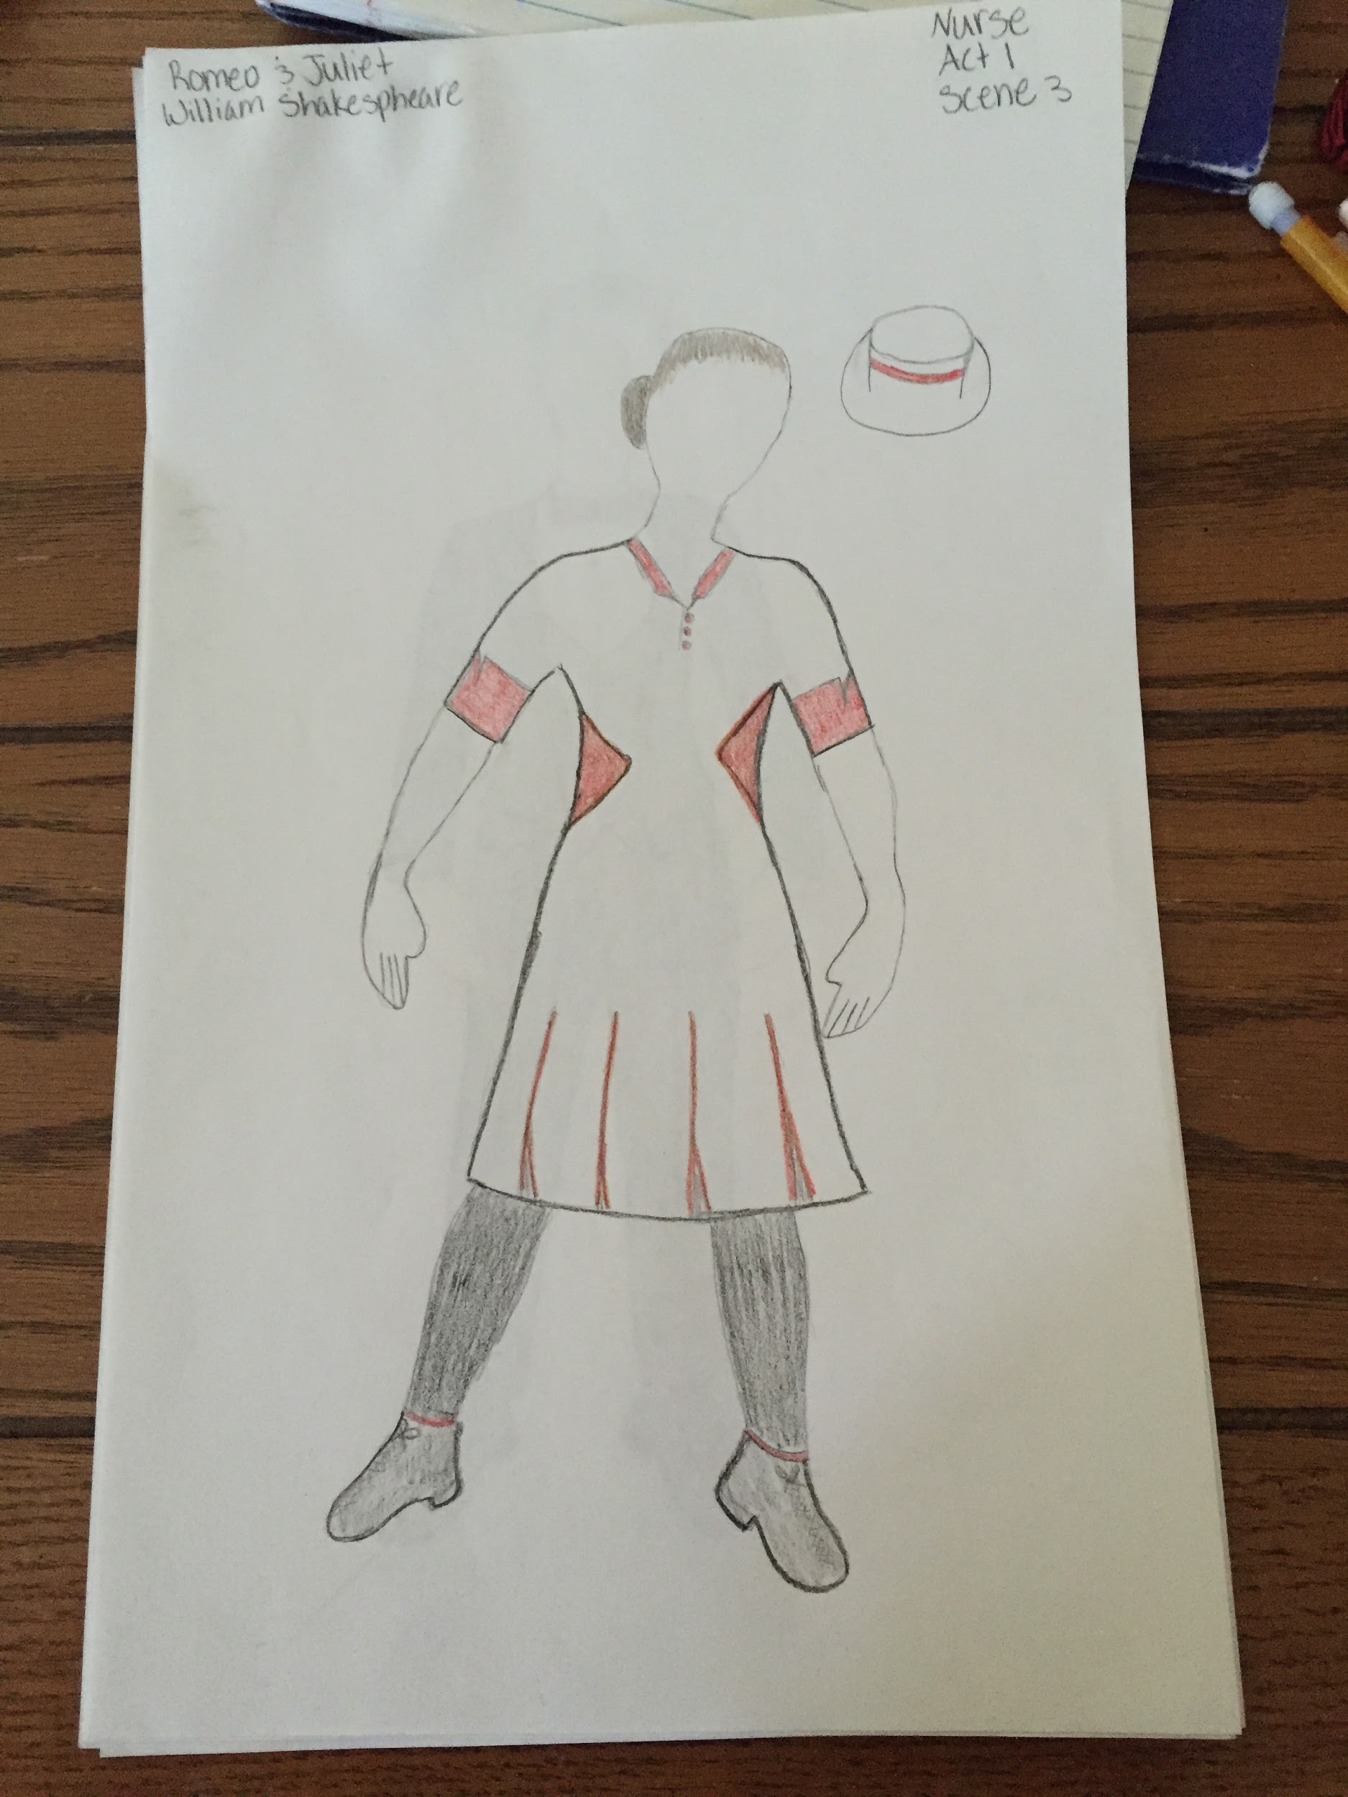
Nurses Cont.
The nurses mostly wore full length, beige dresses with open necks which was new for the time period. The dresses also had a waistline with heavier material so it gave the nurses a shape.
The nurse’s fabric would be wearing cotton broadcloth or percale

Slide 6
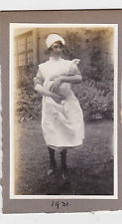
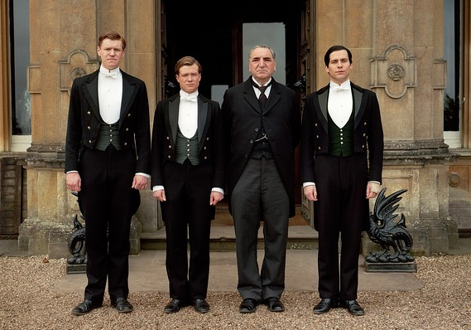
Servants

Slide 7
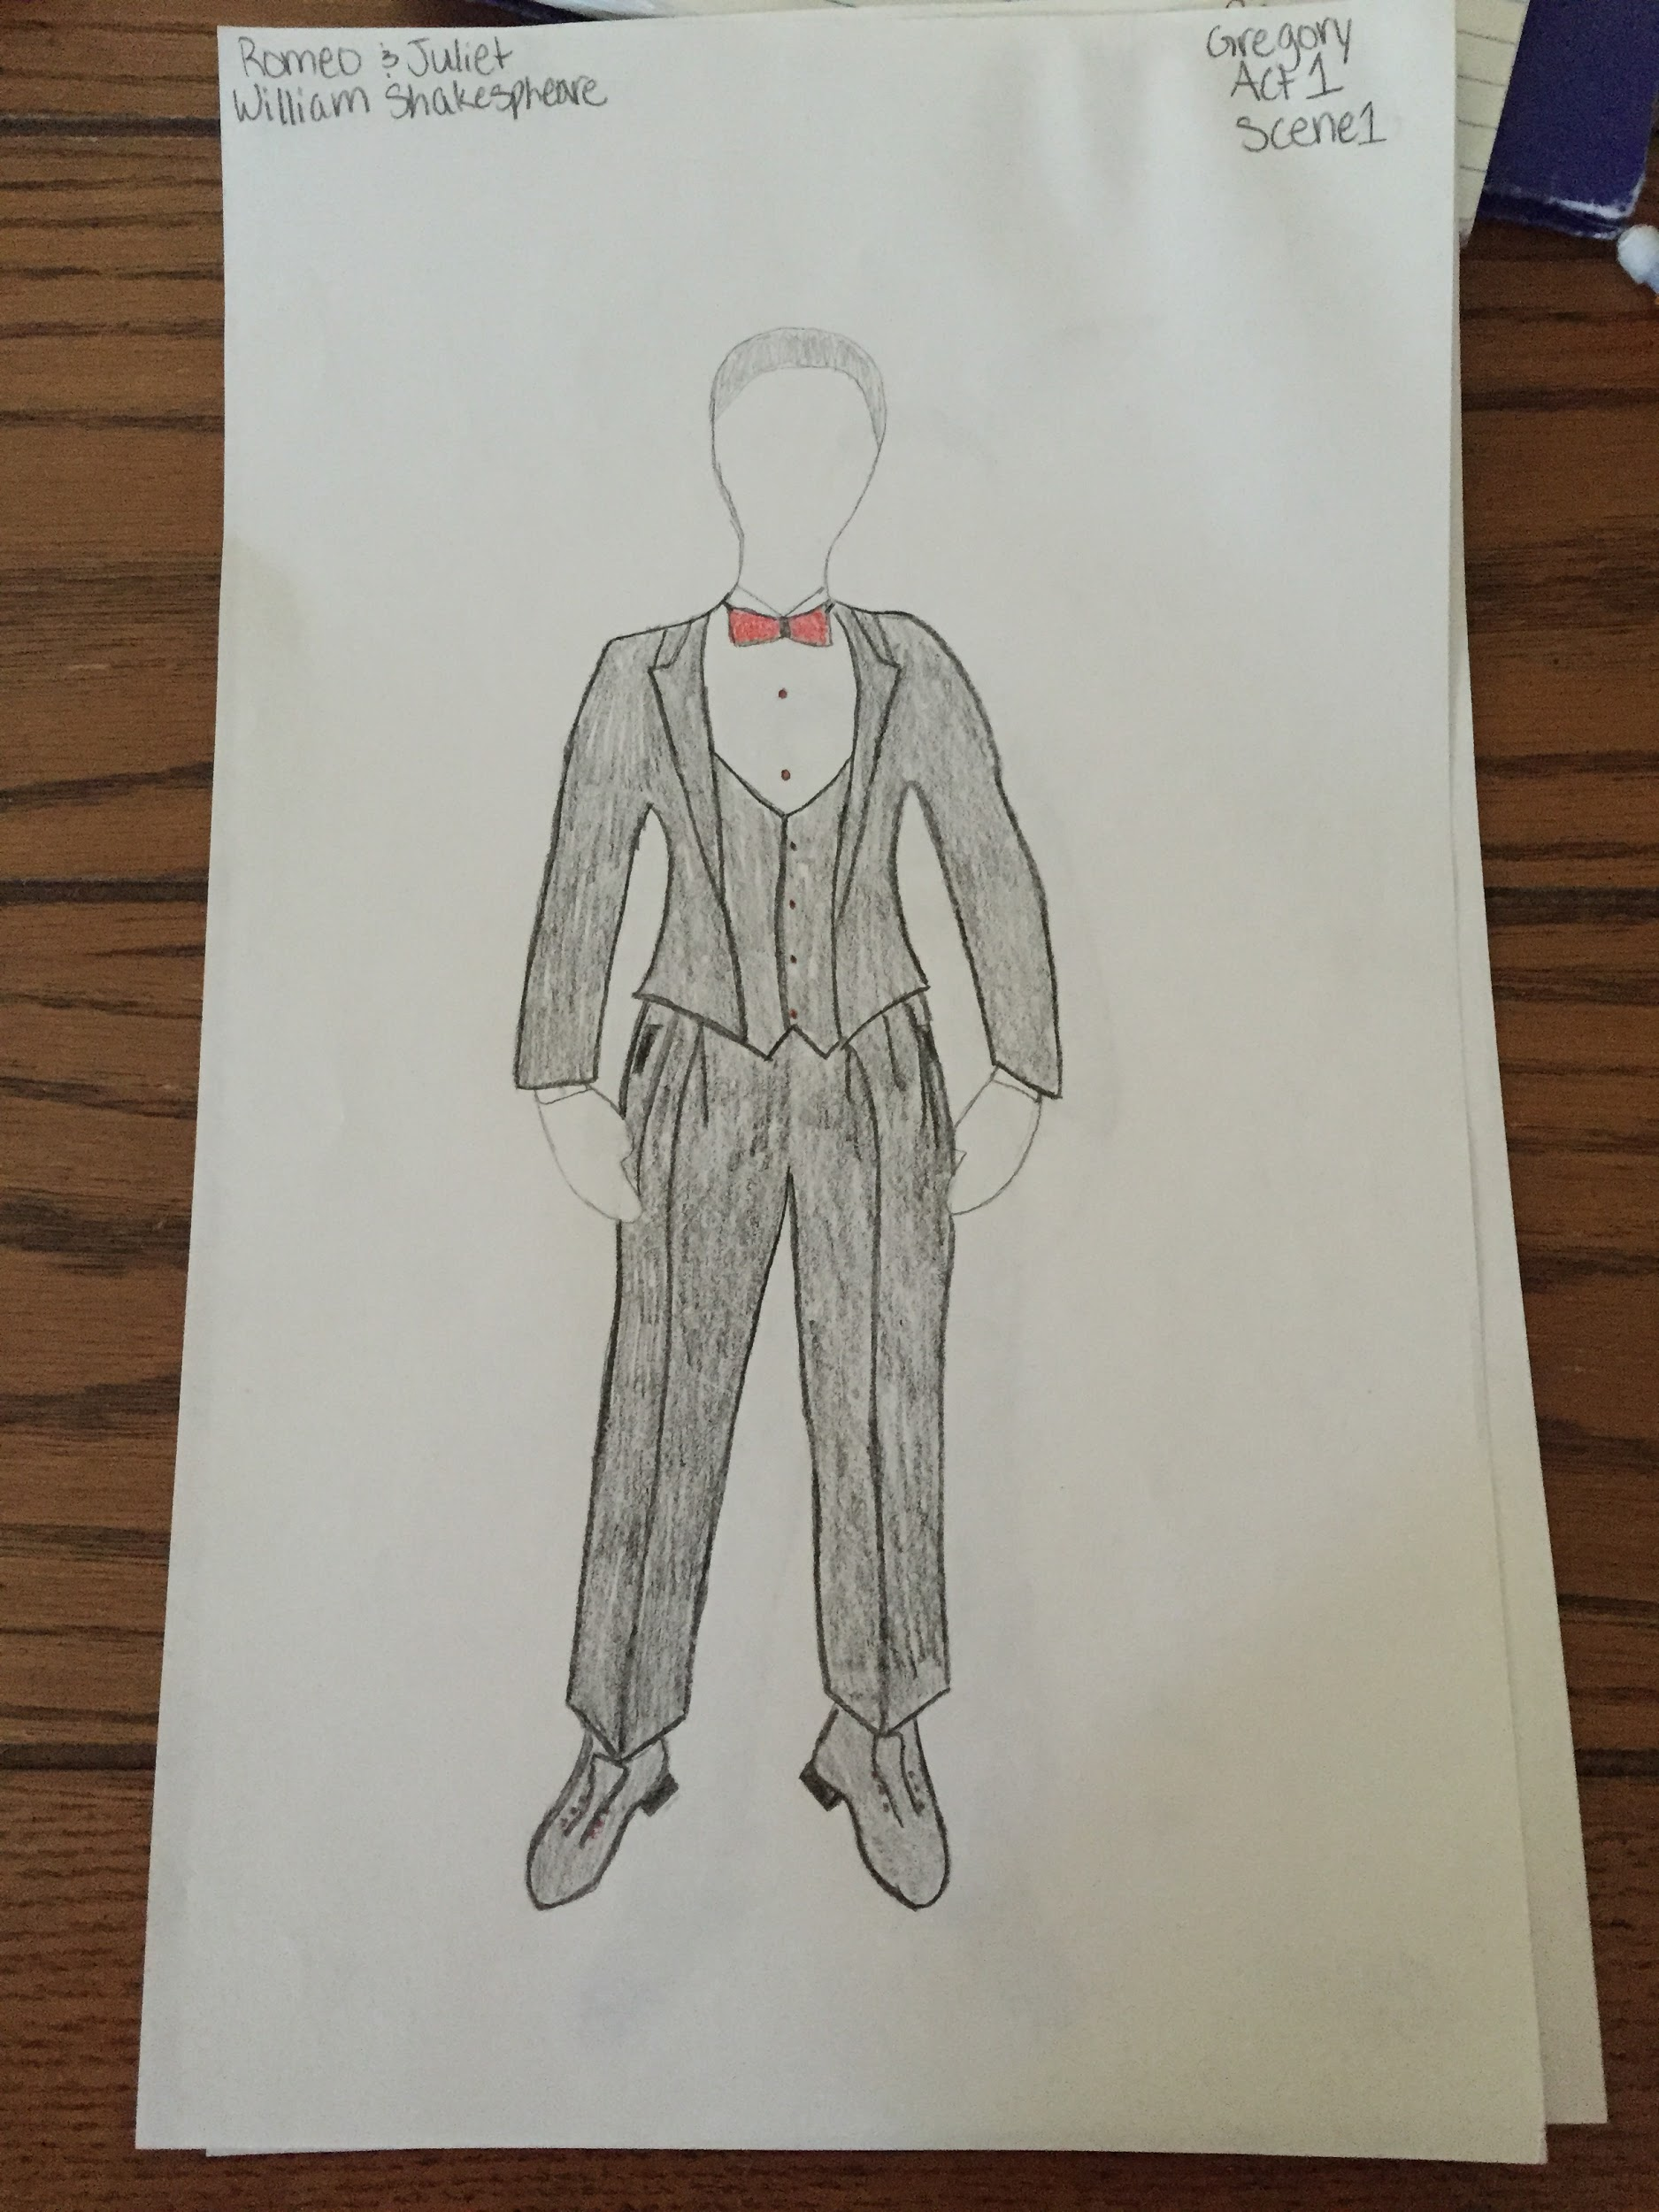
Servants Cont.
Servants had to dress nice enough so when they were seen if would show how much money the family had. Also this is during the depression so very few people had enough money to have servants.
Often dressed in cotton broadcloth because it was easy and cheaper to find and make. You were considered very rich to have a servant during the Depression.

Slide 8
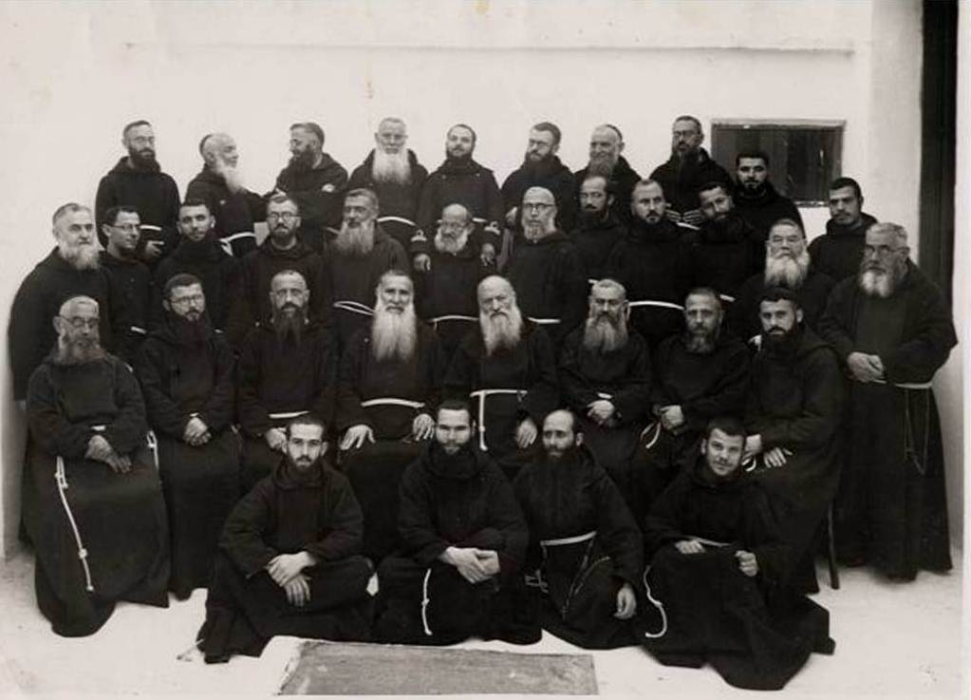
Friars

Slide 9
Friars Cont.
Friars often wore full length black robes during this time era made of synthetic cotton or wool.

Slide 10
Womens Fashion
Women began having a very elegant and sophisticated look to them with alway having gloves, hats, and a beaded purse.
Another growing change was zippers and masculine suits for jobs.
Not many women could get a job without having a suit.
would make shoulders with ruffles to slim the waist
dresses would usually have some sort of belt to make a more defined torso

Slide 11
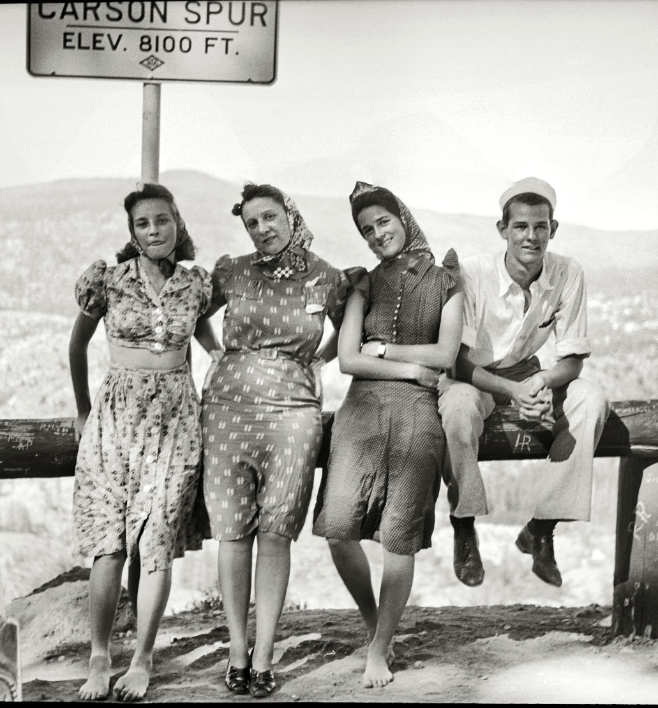
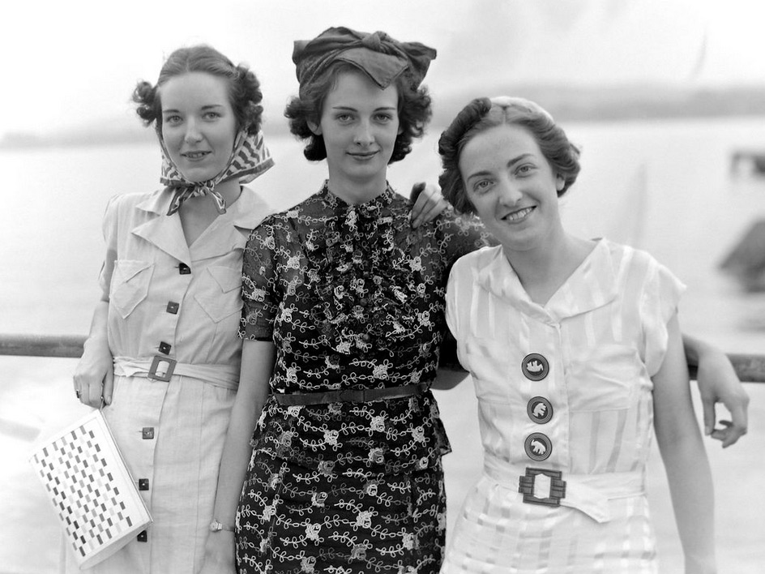
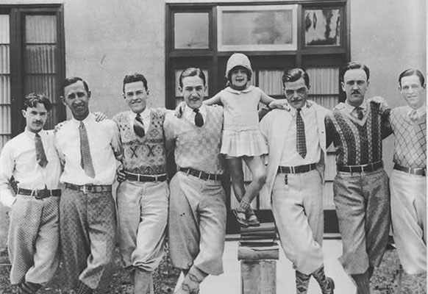
Common Folk

Slide 12
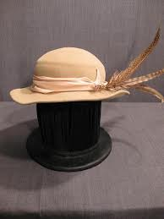
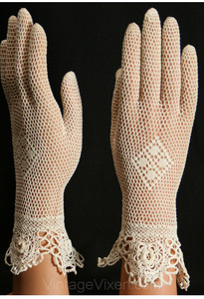
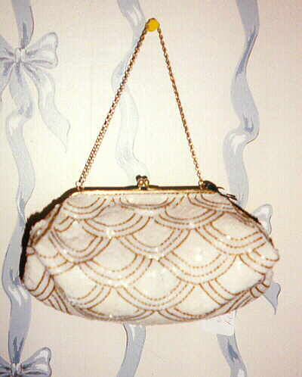
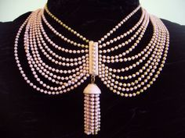
common accessories

Slide 13
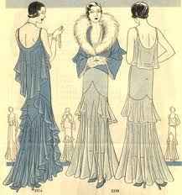
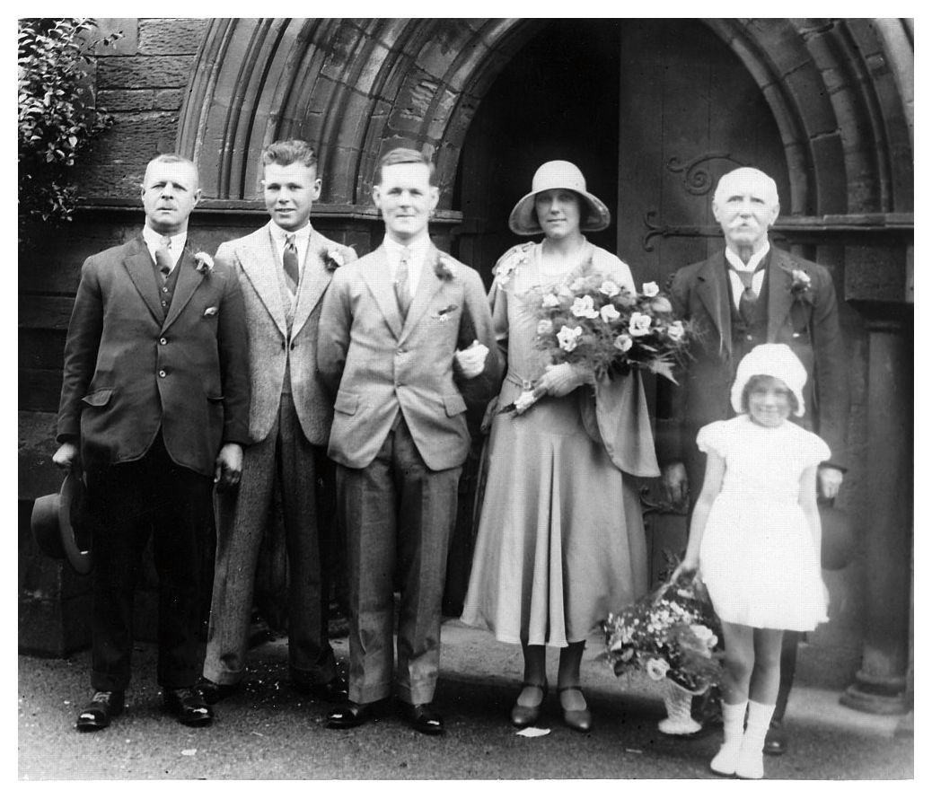
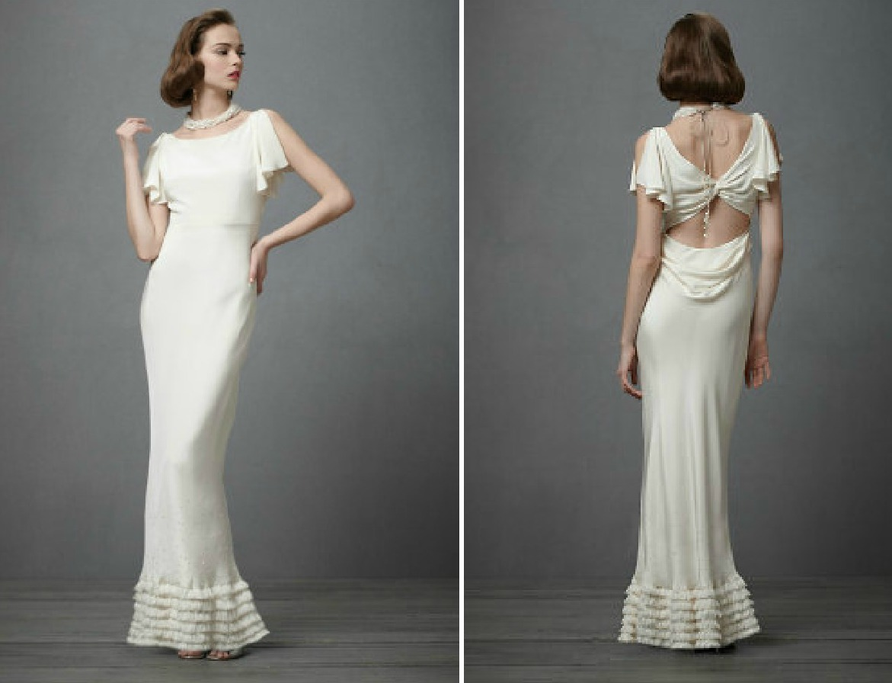
Wealthy People

Slide 14
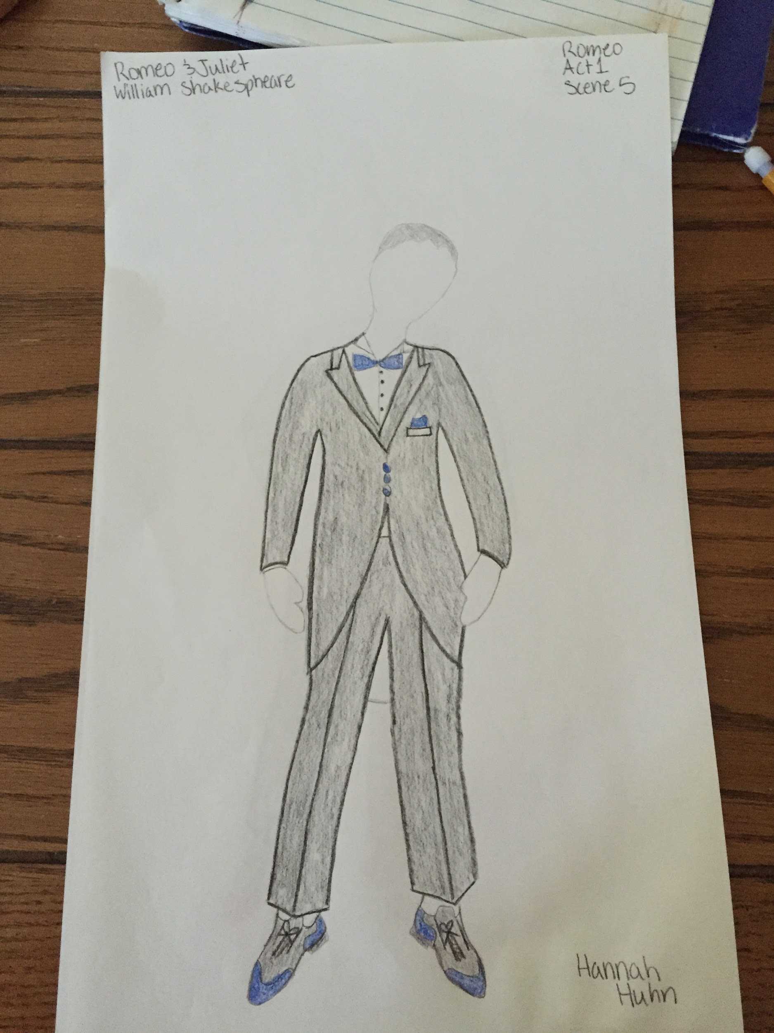
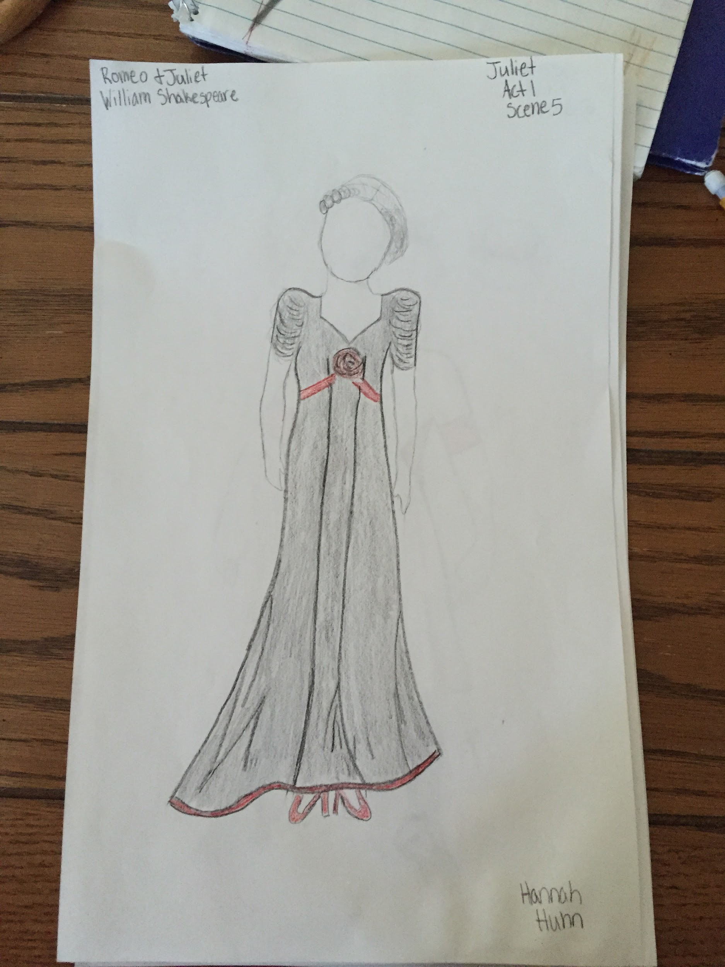
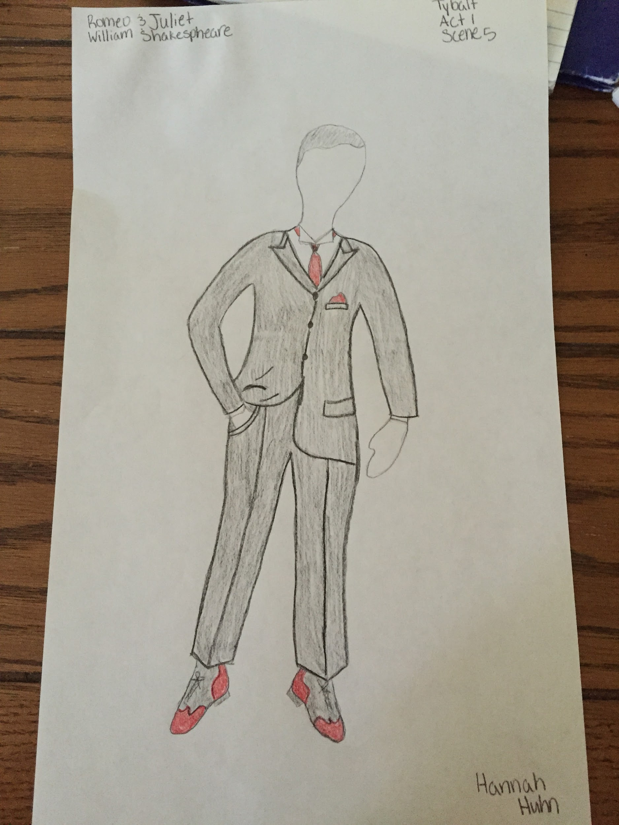
Wealthy Cont.
the wealthy women often wore silk dresses
the men would often wear silk shantung or linen suits

Slide 17
URLs
http://www.davenportandco.com/20's-acc.htm
http://www.polyvore.com/victorianesque_1930s_ivory_crochet_gloves/thing?id=72166615
http://fashion.just-the-swing.com/1930s-womens-fashion
http://www.vintagedancer.com/1930s/
http://www.vintagedancer.com/1930s/1930s-men-fashion-guide/
http://shopruche.com/1930s-fashion.html

