Slide 1
Using the MAEIA Assessments to Demonstrate Educator Effectiveness
Module 8
IN THE MAEIA MODULE SERIES
Notes:
Welcome to this introduction to the Michigan Arts Education Instruction and Assessment project.
In the next few minutes, I will describe some of the important characteristics of this ground-breaking project.

Slide 2
Purposes of MAEIA Project
Improve the quality of your arts education program
Monitor and improve student learning in the arts
Support professional practice and improve teacher effectiveness
Advance arts as a core element of public education
Notes:
There are several Michigan Arts Education Instruction and Assessment or MAEIA project purposes.
The MAEIA project was commissioned by the Michigan Department of Education. It was developed by the Michigan Assessment Consortium working with the Data Recognition Corporation, in partnership with over 1,000 Michigan Educators.
The purposes for MAEIA are to help arts educators
improve their arts education programs,
monitor and improve student learning in the arts,
support professional practice and improve their effectiveness as teachers, and ultimately,
advance arts education as a key part of a well-rounded education.

Slide 3
Overview of the Module Series
Introduction to the MAEIA Project
Overview of the MAEIA Assessments
Overview of the Content Standards Assessed by the MAEIA Assessments
Selecting the MAEIA Assessments
Navigating the MAEIA Website
Using the MAEIA Assessments
Scoring and Reporting the MAEIA Assessments
Using the MAEIA Assessments to Demonstrate Educator Effectiveness
Notes:
There are 8 modules that comprise this module series
The describe the MAEIA program, the MAEIA resources including the MAEIA assessments and other MAEIA resources
The module series also describes how to use the MAEIA resources.
This module describe how an arts educator can use the MAEIA assessments to demonstrate their effectiveness as an educator

Slide 4
Purposes of this Module
Describe three ways that educators can use student performance on the MAEIA assessments to demonstrate their effectiveness.
Explain various ways of summarizing student results.
Methods to summarize student results to demonstrate “growth” are also covered.
Continued . . .
Notes:
There are several purposes for this module. These include
Describe ways that educators can use student performance on the MAEIA assessments to demonstrate their effectiveness.
Explain these different ways of summarizing student results, especially to show growth.

Slide 5
Purposes of this Module
. . . Continued
Present an alternative to statistical procedures.
Documenting student work
Selecting student work for exhibition
Documenting instructional practice
Demonstrating educator effectiveness
Notes:
In addition, this module presents different ways to show educator effectiveness, including
Documenting student work
Selecting student work for exhibition
Documenting instructional practice
Demonstrating educator effectiveness

Slide 6
Using MAEIA Assessments at the Classroom Level
The purpose of model performance assessments in the arts is to improve teaching and learning in the arts.
Notes:
This slides serves as a reminder that the basic purpose of the MAEIA project and the MAEIA assessments is to improve teaching and learning in the arts.

Slide 7
Using MAEIA Assessments at the Classroom Level
When using the model MAEIA assessments
Teachers are allowed to change the assessments to fit their classroom situations.
Teachers should document the processes and student products/performances needed for their professional collaboration and improvement (as part of a teacher’s demonstration of his or her effectiveness).
Notes:
A couple of reminders about the MAEIA assessments
Teachers are allowed to change the assessments to fit better fit their planned classroom instruction.
Teachers should document the processes and student products/performances needed for their professional collaboration and improvement (as part of a teacher’s demonstration of his or her effectiveness).

Slide 8
Demonstrating Educator Effectiveness
The assessment information you collect can be used to demonstrate your effectiveness.
Legislation (PA173 of 2015) adopted in 2015 lists what administrators and teachers must do, as well as what latitude is available.
Notes:
As this slide indicates, the MAEIA assessment information can be used to demonstrate your effectiveness, an activity called for by legislation adopted by the Michigan legislature in 2015 through Public Act 173 of 2015.

Slide 9
PA173 Sec.1249(2) The board of a school district or intermediate school district or board of directors of a public school academy shall ensure that the performance evaluation system for teachers meets all of the following:
Student Growth and Assessment
The performance evaluation system shall include at least an annual year-end evaluation for all teachers. Beginning with the 2015-2016 school year, an annual year-end evaluation shall meet all of the following:
For the 2015-2016, 2016-2017, and 2017-2018 school years, 25% of the annual year-end evaluation shall be based on student growth and assessment data.
Beginning with the 2018-2019 school year, 40% of the annual year-end evaluation shall be based on student growth and assessment data.
Beginning with the 2018-2019 school year, for core content areas in grades and subjects in which state assessments are administered, 50% of student growth must be measured using the state assessments, and the portion of student growth not measured using state assessments must be measured using multiple research-based growth measures or alternative assessments that are rigorous and comparable across schools within the school district, intermediate school district, or public school academy.
Student growth also may be measured by student learning objectives (SLOs) or nationally-normed or locally-adopted assessments that are aligned to state standards, or be based on the achievement of individualized education program goals.
michigan.gov/mde/0,4615,7-140-6530_30334-363616--,00.html
Notes:
This slide shows highlights of Public Act 173.

Slide 10
MAEIA Educator Effectiveness Models
The MAEIA project has created three methods for educators to use in demonstrating their effectiveness.
Two models use pre-post student data, while the third uses an array of student performances.
Each model recognizes that instruction and achievement in the arts is different than content areas such as mathematics or reading.
Each tries to characterize arts achievement in realistic terms, given limits of instructional time.
Notes:
The MAEIA project has created three methods for educators to use in demonstrating their effectiveness.
• Two models use pre-post student data, while the third uses a selection of student performances.
• Each model recognizes that instruction and achievement in the arts is different than in content areas such as mathematics or reading.
• Each tries to characterize arts achievement in realistic terms, given the limits of instructional time.

Slide 11
MAEIA Educator Effectiveness Methods
Each MAEIA assessment is designated for use in one of these methods.
Method 1
Test-retest in the same school year
Method 2
Test-retest in adjacent school years
Method 3
Select examples of
student performance to show student achievement – the “new old-fashioned way” of demonstrating student proficiency
maeia-artsednetwork.org/educator-effectiveness-methods
Notes:
This slide shows a summary of the 3 methods of demonstrating educator effectiveness.
Method 1 is a re-use of the same assessment within the same school year.
Method 2 is the re-use of the same assessment in adjacent years.
Method 3 is the selection of a range of student responses to the assessment to show levels of student achievement – the “new, old-fashioned way” of demonstrating student achievement.

Slide 12
Educator Effectiveness--Method 1
Test-retest in the same school year
A MAEIA assessment is given to students twice:
Fall and spring of the same school year (or start or end of a semester)
Before and after instruction on the content standards measured by the assessment
Most suitable for assessments that can be given in a short period of time – such as MAEIA Performance Events.
Notes:
As this slide indicates, Method 1 is most suitable for assessments that do not take much time to administer. This is typically the Performance Events. In Method 1, the same assessment is given to students before and after instruction which could be at the start and end of the school year, semester, marking period and so on.

Slide 13
Educator Effectiveness--Method 2
Test-retest in adjacent school years
A MAEIA assessment is given to students twice:
Fall (or spring) of adjacent school years
Pre-test and instruction in the first school year assessment, with post-test in second year
Most suitable for assessments that require longer periods of time to administer – such as MAEIA Performance Tasks.
Feasible because the same arts educator might instruct the same students over multiple grade levels.
Notes:
Method 2 is similar to Method 1, except the pre-test and post-test occur in adjacent school years which may be feasible because you have the same students for two or more grade levels.
Method 2 may be more suitable for lengthier assessments, such as the MAEIA Performance Tasks, but again, the assessment should occur before and after instruction has taken place.

Slide 14
Educator Effectiveness--Method 3
Select examples of student performance to show student achievement.
Some MAEIA assessments are unique; doing them twice (as in Models 1 and 2) wouldn’t be useful or interesting to students nor informative to teachers.
Educators have typically demonstrated their effectiveness by selecting exemplars of student work for exhibition in their classrooms.
This has been done traditionally, so we nick-named it the “new old-fashioned” method.
Model 3 is suitable for any MAEIA assessment.
Notes:
Method 3 is a more traditional method for showing what students know and/or are able to do. Hence, the nickname “the new old fashioned way” of showing student achievement.
This method has been assigned to assessments that are so unique that doing them twice wouldn’t be as useful or interesting to students nor informative to teachers.
Traditionally, educators have demonstrated their effectiveness by selecting exemplars of student work for exhibition in their classrooms; that is what this method is at its heart.
Note that Model 3 is suitable for any MAEIA assessment, even those labeled as Method 1 or 2.

Slide 15
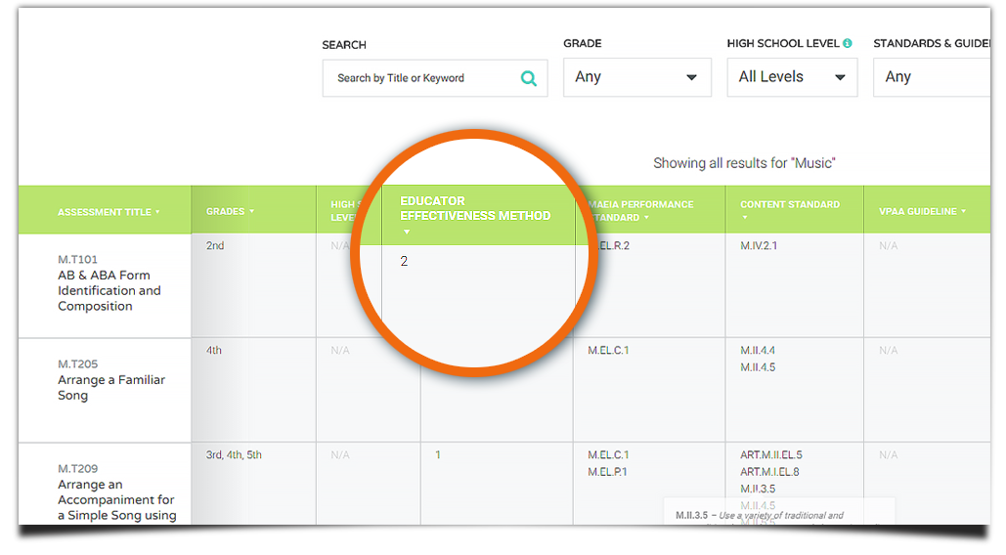
Educator Effectiveness Methods are included in the Online Assessment Catalogue
Notes:
The MAEIA online catalog shows the suggested method for arts educators to use for each assessment to demonstrate their effectiveness.

Slide 16
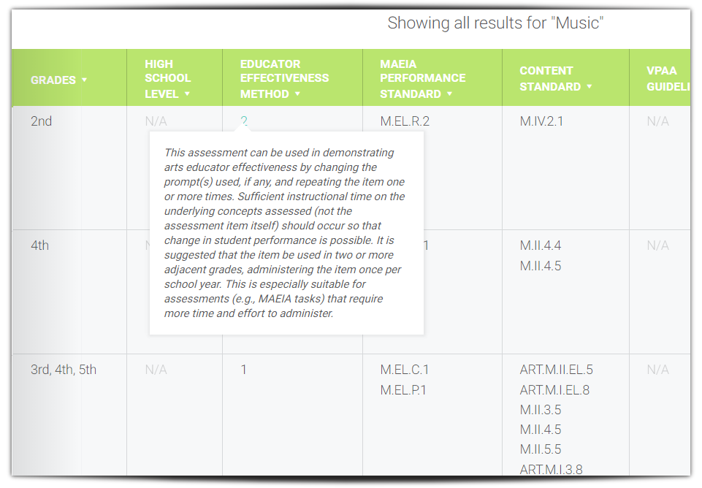
Hover on the number to see a description of the method.
Notes:
As this slide shows, if you hover on the item number, a brief description of the method for demonstrating educator effectiveness will appear.

Slide 17
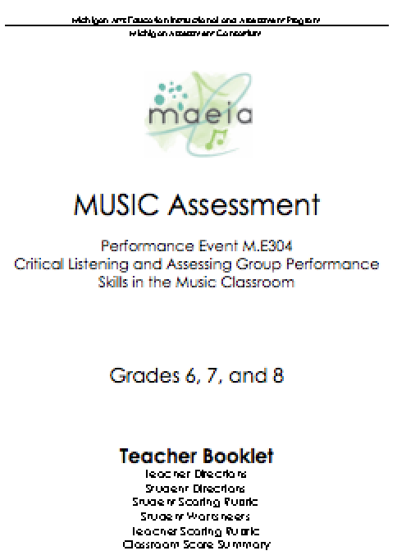
How to Use Methods 1 and 2
For Methods 1 and 2, the teacher should first score each student’s responses, using the Teacher Scoring Rubrics found in the Teacher Booklet.
Notes:
Now, turn to how to actually produce numerical data for use in demonstrating your effectiveness.
If using Methods 1 and 2, the teacher should first score each student’s responses, using each Teacher Scoring Rubric found in the Teacher Booklet

Slide 18
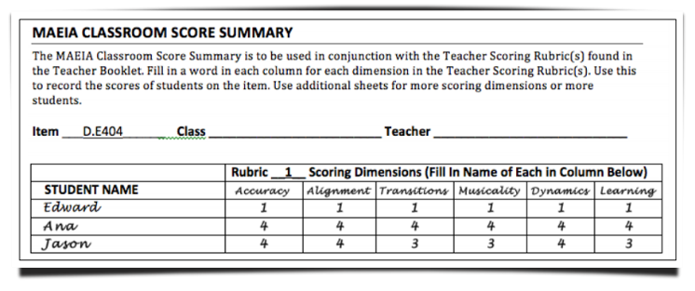
How to Use Methods 1 and 2
Next, fill out the MAEIA Classroom Score Summary page(s).
Please see Module 7 and the MAEIA Assessment Administration Manual for more information about score summaries.
maeia-artsednetwork.org/model-assessments
Notes:
Next, fill out the MAEIA Classroom Score Summary page or pages with your scores for each student for each dimension of each Teacher Scoring Rubric.

Slide 19
How to Use Methods 1 and 2
Now calculate a “total score” for each student by summing the scores on each dimension in the rubric.
Do this each time the assessment is used.
Subtract the Time 1 (pre-test) score from the Time 2 (post-test) score for each student; the result will usually be positive.
More detailed information is presented in:
maeia.wpengine.com/wp-content/uploads/2016/02/Using-MAEIA-Asst-to-Demontrate-Educator-Effectiveness-v.-5.1.pdf
Notes:
Now calculate a “total score” for each student across the different dimensions on each Teacher Scoring Rubric. Do this by summing the score across the dimensions in the rubric.
Do this each time the assessment is used – pre- and post-test.
Subtract the Time 1 (pre-test) scores from the Time 2 (post-test) score for each student; the result will usually be positive.
More detailed information is presented in the Educator Effectiveness booklet available from this URL on the MAEIA website:
maeia.wpengine.com/wp-content/uploads/2016/02/Using-MAEIA-Asst-to-Demontrate-Educator-Effectiveness-v.-5.1.pdf

Slide 20
How to Use Methods 1 and 2
Choose a way to display your data:
Calculate a Mean Change Score for the classroom.
Construct an Achievement Change Table
to show levels
of change.
Notes:
There are two ways that you can show the data. The first is to calculate a mean change score for all students included in the group.
Alternatively you could construct an achievement change table to show changes from the pre- to post-test for the group of students.

Slide 21
How to Use Methods 1 and 2
Calculate a Mean Change Score for the classroom:
Add up the individual student change scores (sum of all individual T2-T1 scores).
Divide this number by the number of students (sum of T2-T1/N).
Do this for each MAEIA assessment used.
Notes:
This slide describes how to calculate the mean change score for a group of students.
Calculate a change score for each students – T2 score – T1 score.
Next, add up the individual student change scores (sum of all individual T2-T1 scores).
Divide this number by the number of students (Sum of T2-T1/N).
Do this for each MAEIA assessment used.

Slide 22
How to Use Methods 1 and 2
Set up a table that shows several levels of change (gains or losses)
Ways to display the data:
Construct an Achievement Change Table to show levels of change for students in the classroom:
Up +20 points or more
Up +10 to +19 points
Up +1 to + 9 points
Unchanged
Down -1 to -9 points
Down -10 to -19 points
Down -20 points or more
Report the number and percentage of students in each category.
Notes:
A second method is to construct an Achievement Change Table to show levels of change for student in the classroom.
Set up a table that shows several levels of change (gains or losses) using categories of change like those shown in the slide.
Up +20 points or more
Up +10 to +19 points
Up +1 to + 9 points
Unchanged
Down -1 to -9 points
Down -10 to -19 points
Down -20 points or more
Report the number and percentage of students in each category.

Slide 23
Example Achievement Change Table
–20 points or more | –10 to –19 points | –1 to – 9 points | No Change | +1 to +9 points | +10 to +19 points | +20 points or more
Number | 1 | 4 | 6 | 8 | 7 | 4
Percent | 3.3% | 12.1% | 20.0% | 26.7% | 23.3% | 12.1%
Notes:
This slide illustrates what a Achievement Change Table to show levels of change might look like. From this table, you can see that two-thirds of the students (19 of 30) improved in performance, 6 of 30 remained the same, and 5 of 30 declined in performance.

Slide 24
How to Use Method 3
Select exemplars from student groups such as these to demonstrate overall achievement in your classroom:
Students who were already high achieving: How did they do on the assessments used? Did they improve?
Students who were initially struggling: Have they done well on the assessments used? Are they more confident learners?
Students who initially struggled to perform at all: Who is now performing and perhaps doing much better?
Notes:
This slide suggests some ways to select exemplars of student performance for Method 3, the “new, old-fashioned way” of showing educator effectiveness.
Select exemplars from student groups such as these to demonstrate overall achievement in your classroom:
Students who were already high achieving: How did they do on the assessments used? Did they improve?
Students who were initially struggling: Have they done well on the assessments used? Are they more confident learners?
Students who initially struggled to perform at all: Who is now performing and perhaps doing much better?

Slide 25
Documenting Teacher Instruction is Essential!
Instructional information should be used along with student performance to demonstrate educator effectiveness.
Notes:
As this slides notes, instructional information should be used along with student performance to demonstrate educator effectiveness.

Slide 26
Documenting Teacher Instruction
You may want to create a log of what you did instructionally on each content standard assessed.
A concise narrative summary of this for your supervisor would make it most useful.
The log and summary may be written, or you may use video of classroom instruction, student work, and student reflections on the assessment in the classroom.
Notes:
You may want to create a log of what you did instructionally on each content standard assessed.
A concise narrative summary of this for your supervisor would make it most useful. Video excerpts of instruction can help too.
The log and summary may be written, or you may use video of student work in progress, student performances, and student reflections on the assessment in the classroom.

Slide 27
Teacher Reflections on the Assessment and Student Learning
Once the teacher has taught the content standards, documented instruction, and collected, scored, and analyzed student achievement, the teacher should prepare a concise reflection on what he or she learned.
Notes:
Once all of the information has been collected, scored, and analyzed, the teacher should prepare a concise reflection on what he or she learned annotated with the examples of student work, videos of instruction or student work and performances, and their reflections.

Slide 28
Teacher Reflections on the Assessment and Student Learning
What worked and what didn’t?
What formative information was collected during instruction or assessment and what changes in instruction did you make?
What did you learn about your students – their achievement and attitudes?
How did you use this information?
Notes:
In reflecting on your work as an educator and the achievement of your students, reflect on the following questions
What worked and what didn’t? What would you do differently?
What formative information was collected during instruction or assessment and what changes in instruction did you make?
What did you learn about your students – their achievement and attitudes?
How did you use this information?

Slide 29
Putting it All Together
The teacher should prepare a portfolio of evidence for each assessment.
Statistical summaries of student achievement – Mean Change Score and/or Achievement Change Table
Samples of student work, both pre- and post-test, if used
Documentation (written or video) of the teacher’s instruction on the standards that were assessed
Student reflections on their learning, both written and video
Teacher’s reflective summary about instruction and assessment
Notes:
To put all of this together, the teacher should prepare a portfolio of evidence for each assessment, with
statistical summaries of student achievement – Mean Change Score and/or Achievement Change Table.
samples of student work, both pre- and post-test, if used.
documentation (written or video) of the teacher’s instruction on the standards that were assessed.
student reflections on their learning, both written and video.
teacher’s reflective summary about instruction and assessment.

Slide 30
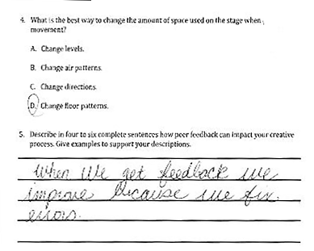
How to Use the MAEIA Results for Educator Effectiveness
Other sources of achievement and outcome data (e.g., other measures or indicators of achievement) should be used as well.
Prepare corresponding narratives regarding teacher practices to accompany student assessment results.
These achievement data, along with appropriate observational data, should be used in the overall evaluation of an educator.
The goal of educator evaluation should primarily be improvement of educator practice.
Notes:
As this slide notes, think about demonstrating your effectiveness more broadly.
Other sources of achievement and outcome data (e.g., other measures or indicators of achievement) should be used as well.
Prepare corresponding narratives regarding teacher practices to accompany student assessment results.
These achievement data, along with appropriate observational data, should be used in the overall evaluation of an educator.
It is our belief that the main goal of educators demonstrating their effectiveness with educator evaluation system is primarily to improve educator practice.

Slide 31
maeia-artsednetwork.org
Notes:
Be sure to join the community of arts educators to discuss these and other ideas. Register on the site (see the word “Register” in the upper right hand corner), and join with other arts educators in improving your arts education programs.

Slide 32
Contact Us
MAEIA Project
517-816-4520
maeia.artsed@gmail.com

