Slide 1
Michigan Department of Education Music Grant (33c)
Due December 15, 2023
Notes:
Add the title of your presentation on the left-hand side of the slide.

Slide 2
Updates
1
The legislation
2
The eligibility criteria
3
The application
4
Frequently asked questions
5
Contacts for support
Notes:
Add in the objectives for your session. You can also change the title to be Agenda or Outline if that better suits your presentation.

Slide 3
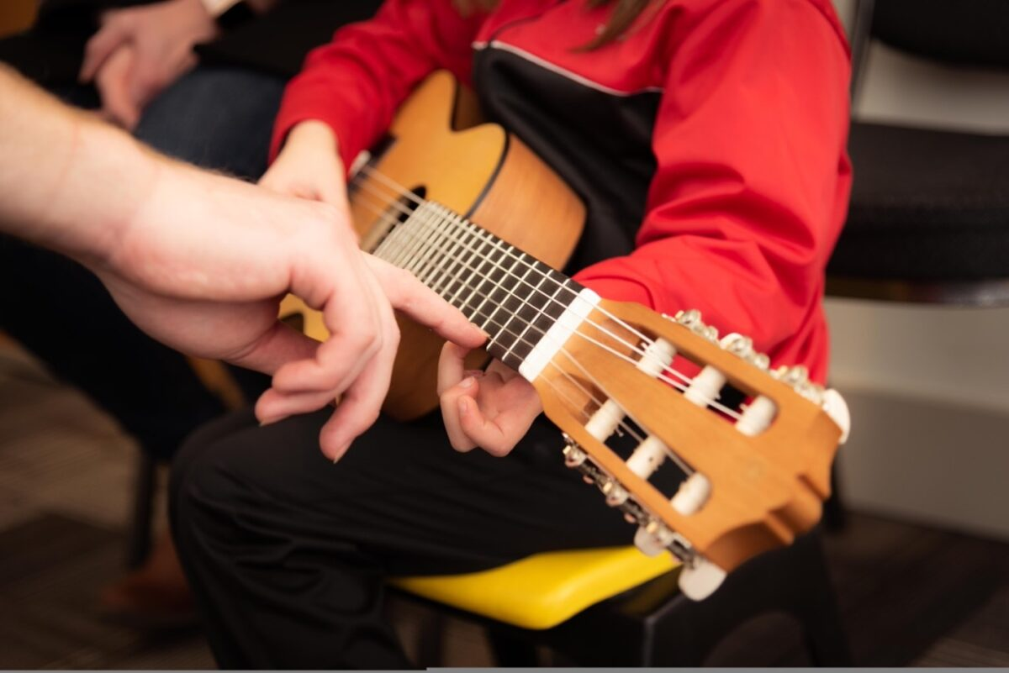
Section 33 of the 2023-24 School Aid Bill
Music Education for K-5
Provides $11,000,000.00 for starting a music program for schools with students in kindergarten through grade five.

Slide 4
The Eligibility Criteria
Grant funding is based on the following requirements to be considered an eligible recipient for an allocation:
Applies for funding in a form and manner prescribed by the department.
Provide for all pupils in grades K to 5 at least 90 minutes per week of instruction in music, taught by a certificated teacher with a JX or JQ endorsement issued by the department.
Maintain staffing that includes at least 1 certificated teacher with a JX or JQ endorsement issued by the department for every 400 pupils enrolled in grades K to 5.
Adopt and implement specific curricula for music.
Maintain in each elementary school at least 1 space that is designated for music instruction and that allows for effective implementation of the music curriculum, with consideration given to the physical materials and tools needed for music instruction.
Establish and maintain a separate dedicated budget for music instruction in grades K to 5.

Slide 5
A Music Curriculum
For your consideration:
MAEIA’s Sample Curriculum Map for K-5
Offers sequential map of instruction aligned to Michigan’s standards as well as the National Core Arts Standards.
Includes appropriate assessments
Can be modified to support the educator’s areas of expertise as well as the needs and experiences of the students
District developed curriculum
For previously existing programs
Educator developed curriculum with K-5 experience
Vendor-based curriculum
Adoption and delivery of music curriculum to K-5 students in a school that does not already have a music program.

Slide 6
A Schedule
For your consideration:
Michigan Blueprint for Quality Education
Available on at www.maeia-artsednetwork.org under Program Review
90 minutes of arts instruction per discipline, per week
45 minutes per class
Creativity invited provided it totals 90 minutes weekly
Example provided in the MAEIA Sample Application
Credentialed Educator
Certified educator, endorsed in Music
To locate prospective educators, turn to the music education associations
listed in the FAQ
A schedule that provides ninety minutes per week of music instruction provided by a teacher with a JX or JQ endorsement.

Slide 7
A Designated Space
For your consideration:
A dedicated space for music education with appropriate storage, space for movement
A versatile space that can adequately accommodate music instruction with nearby availability for storage
A traveling classroom, also known as music on a cart, providing this supports the effective instruction of the adopted curriculum. Ideally, this would be a temporary option while a more permanent space is developed.
A designated space for music instruction

Slide 8
A Budget
For your consideration:
Approved expenditures
Teacher salary
Music curriculum purchase
Instrument purchase and repair
Music technology and software
Recording equipment
Sheet music
Other applicable costs
Expenses should support the needs of the students and the curriculum
Carpet squares
Props for movement and gross motor skill development
Supports for adaptations
A dedicated budget for K-5 music instruction must be created and maintained. Budget can include teacher salary, music curriculum purchase, instrument purchase and repair, music technology and software, recording equipment, sheet music and other applicable costs.

Slide 9
The application
Each 33c music grant application must include all of the following:
A completed application template uploaded into NexSys.
A schedule showing 90 minutes of music instruction per week for K-5 students in the building uploaded into NexSys.
A detailed budget that links to the activities, resources, and personnel uploaded into NexSys.
Applications will be due December 15, 2023.
Selection Process
The review and scoring of each application will be based on criteria outlined in the scoring rubric/checklist. An expert review panel will be sure that all grant requirements are met and the budget is reasonable and aligns with the submitted template. Grant applications are due December 15, 2023. Awardees will be announced by January 12, 2024.
NexSys platform will open on December 1, 2023.
Applications will be due December 15, 2023.

Slide 10
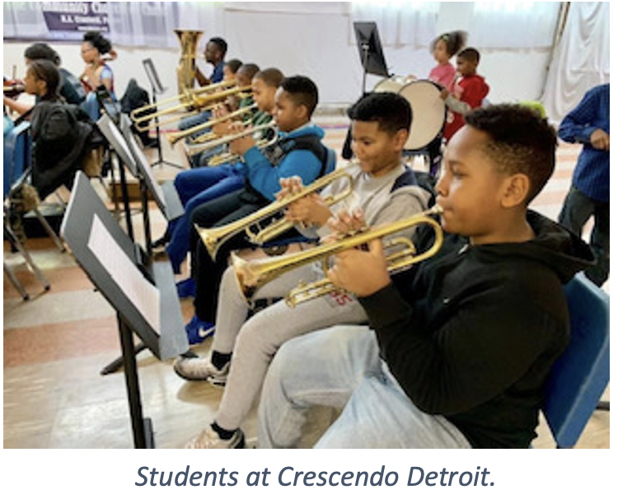
Frequently Asked Questions

Slide 11
FAQ
Why is this grant exclusive to music education and not dance, theatre, or visual arts?
Will this grant be available next year?
Must the grant funds be spent in the 2023-24 academic year?
Do all criteria need to be met for consideration of funds?
The timeline of this application and submission deadline is short. What if our school board does not, or cannot, approve a curricula before the application deadline?
On what basis will the funds be awarded?
Does this grant require a final report?
Answers available on the FAQ document, available on MAEIA Music Grant (33c) page of MAEIA website

Slide 12
MAEIA Engagement for your new Music Educator
Professional Learning
Contact Heather Vaughan-Southard at
hvsouthard@gmail.com
Assessment in the Arts
Continuous Improvement Planning in the Arts
Demonstrating Educator Effectiveness
SEL and Culturally Responsive Teaching in and through the Arts
Formative Assessment for Michigan Educators (FAME) program offered through the Michigan Department of Education
famemichigan.org
MAEIA Re-Ignite
Annual virtual convening of the arts education community.
October 2024
Build a Better Assessment Future Conference
East Lansing, MI
Aug 6-7, 2024
MichiganAssessmentConsortium.com
Better Together in the Arts
A live, virtual professional learning series
MAEIA Reads
A virtual book club focused on arts education
MAEIA Academy
A hub for virtual professional learning in arts education
www.maeia-artsednetwork.org

Slide 13
Contacts for Support
Michigan Department of Education
Mary Head, Office of Educational Supports, at HeadM1@michigan.gov.
For technical assistance, please contact Dylan Rozansky, Office of Educational Supports, Michigan Department of Education at rozanskyd@michigan.gov.
MAEIA
Heather Vaughan-Southard, MAEIA Professional Learning Director, at hvsouthard@gmail.com.

